Slide 1
Fundamentals of CRE
Chemical Reaction Engineering
By
Dr Salah N. Farhan
Senior lecturer. Chem. Eng. Dept.
College of Engineering
University of Diyala
Salah N. Farhan College of Engineering Diyala University

Slide 2
Fundamentals of CRE
Chapter 12: Rate law from experimental
Salah N. Farhan College of Engineering Diyala University

Slide 9
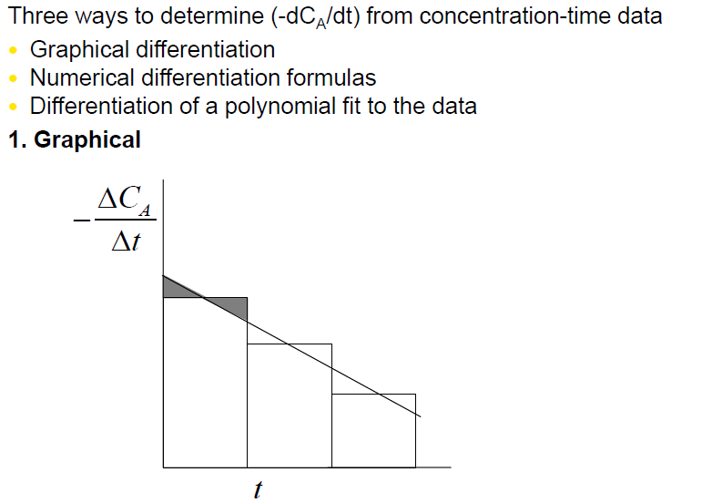

Slide 10
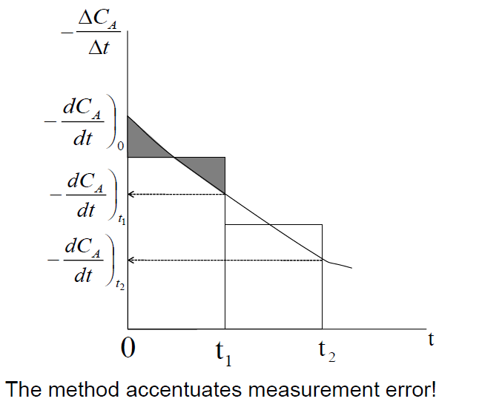

Slide 18
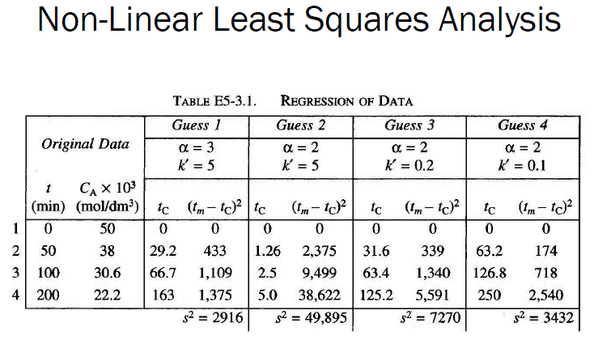

Slide 20
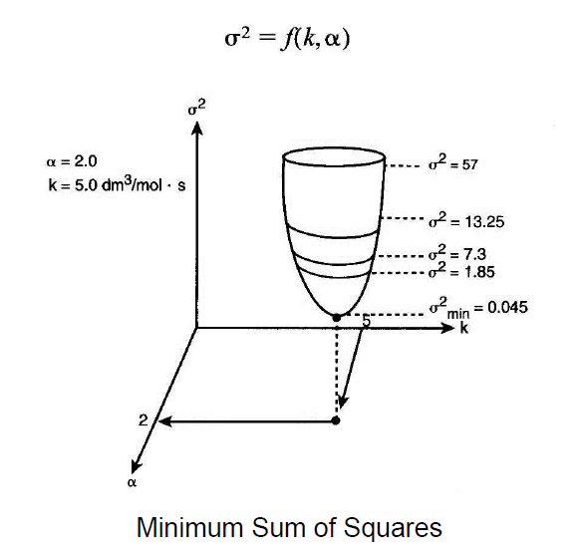

Slide 21
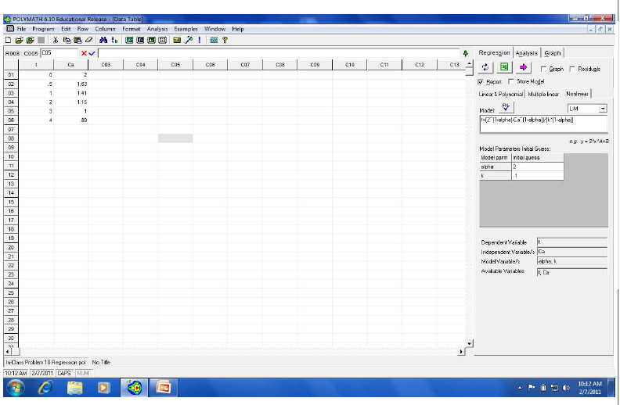

Slide 22
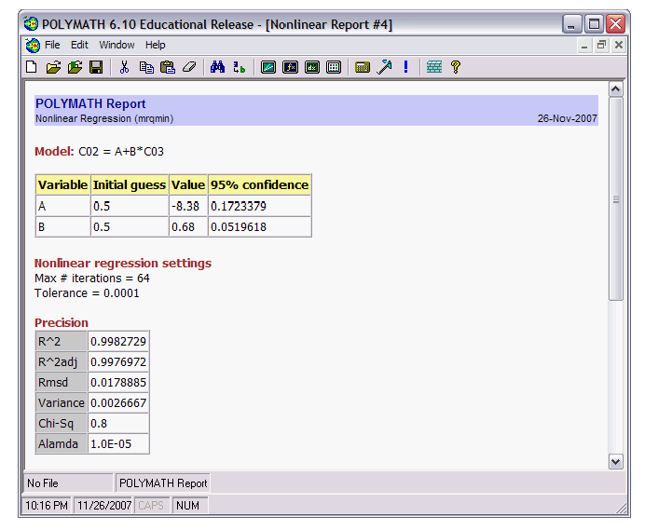

Slide 23
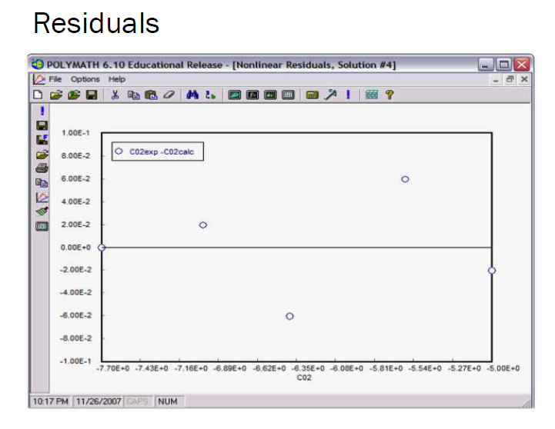

Slide 24
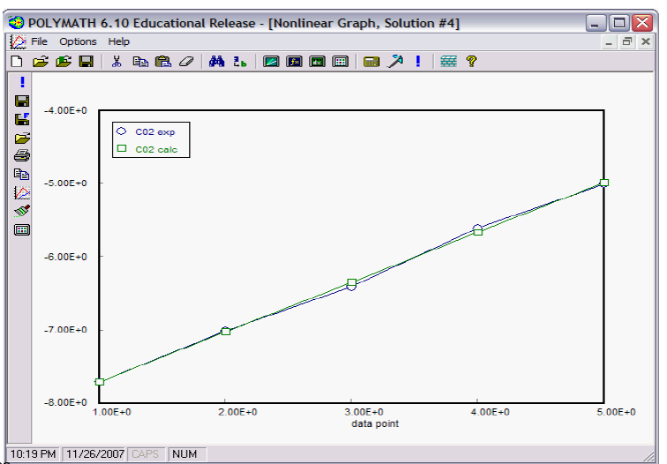

Slide 26
Fundamentals of CRE
Salah N. Farhan College of Engineering Diyala University

Slide 27
Fundamentals of CRE
Salah N. Farhan College of Engineering Diyala University

Slide 28
Fundamentals of CRE
Salah N. Farhan College of Engineering Diyala University

Slide 29
Fundamentals of CRE
Salah N. Farhan College of Engineering Diyala University

Slide 30
Fundamentals of CRE
Salah N. Farhan College of Engineering Diyala University

Slide 31
Fundamentals of CRE
Salah N. Farhan College of Engineering Diyala University

Slide 32
Fundamentals of CRE
Salah N. Farhan College of Engineering Diyala University

Slide 33
Fundamentals of CRE
Salah N. Farhan College of Engineering Diyala University

Slide 34
Fundamentals of CRE
Salah N. Farhan College of Engineering Diyala University

Slide 35
Fundamentals of CRE
Salah N. Farhan College of Engineering Diyala University

